Slide 1
Compiling Improving Streaming with JUCE and Visual Studio 2019

Slide 2
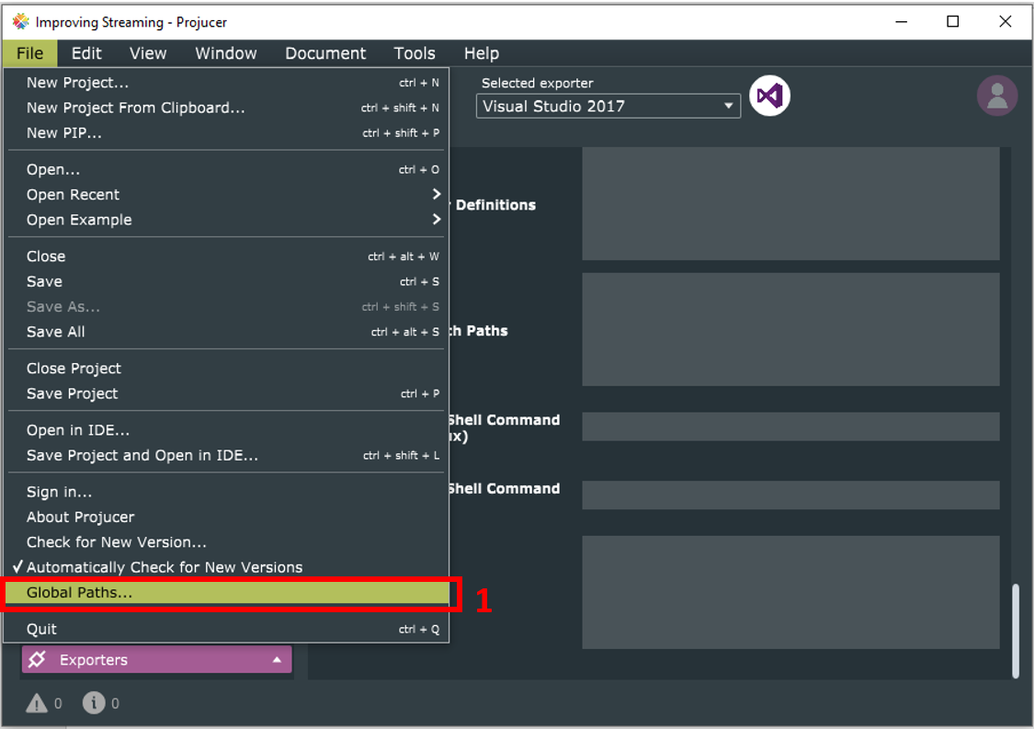
After uncompressing JUCE, put it under c:\ root directory, and open Projucer running Projucer.exe
Go to File Menú, and select Global Paths in order to configure SDK for VST 2.0 path

Slide 3
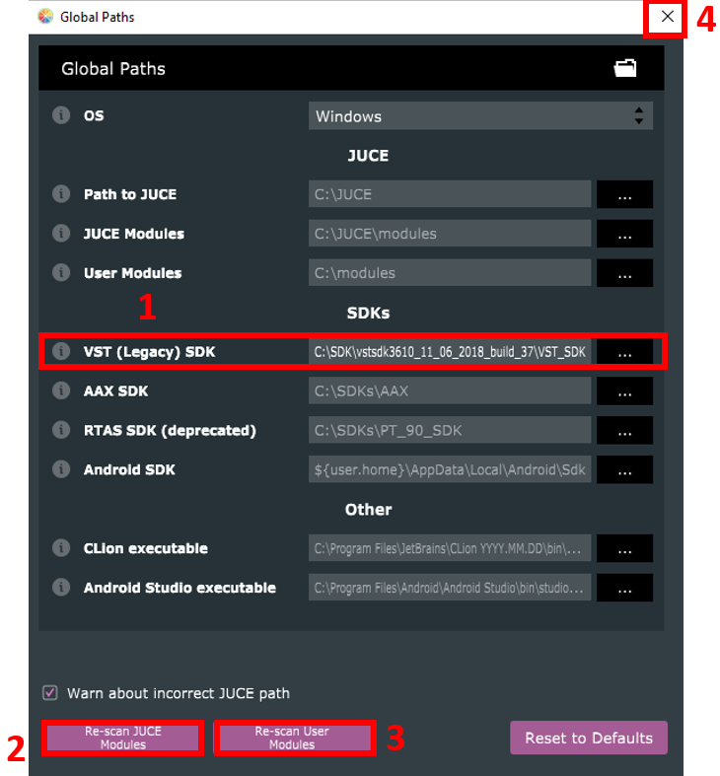
Configuration paths window will open. Ensure to set your path to C:\SDK\vstsdk3610_11_06_2018_build_37\VST_SDK\VST2_SDK to let JUCE compile for VS2 standard (references for their libraries are set with VST2_SDK as root folder. If you choose other it wont work.
Let JUCE re-scan both, Juce and User modules
Dont worry about other SDK’s paths unless you want to compile for that architecture.
Close that window

Slide 4
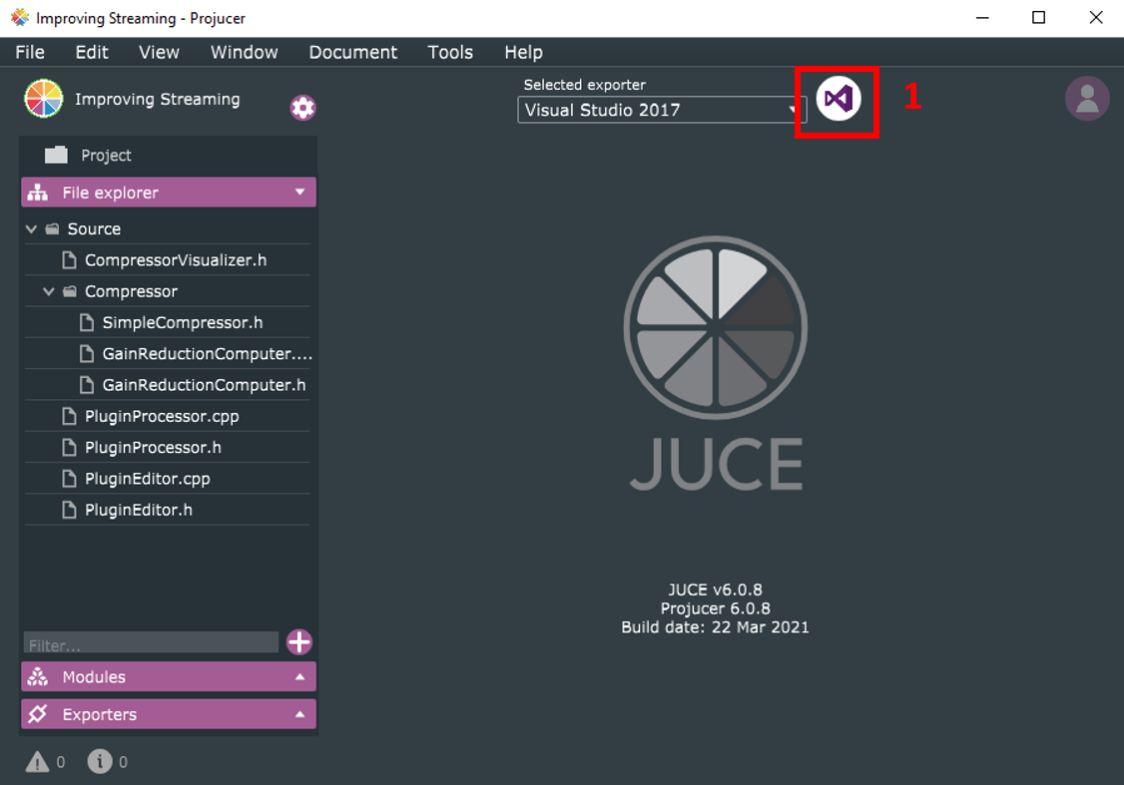
Back in Projucer window, click on the top right Visual Studio Icon to open the SLN file with Visual Studio 2019.
If asked, open it with Visual Studio, not with Solution Explorer.

Slide 5
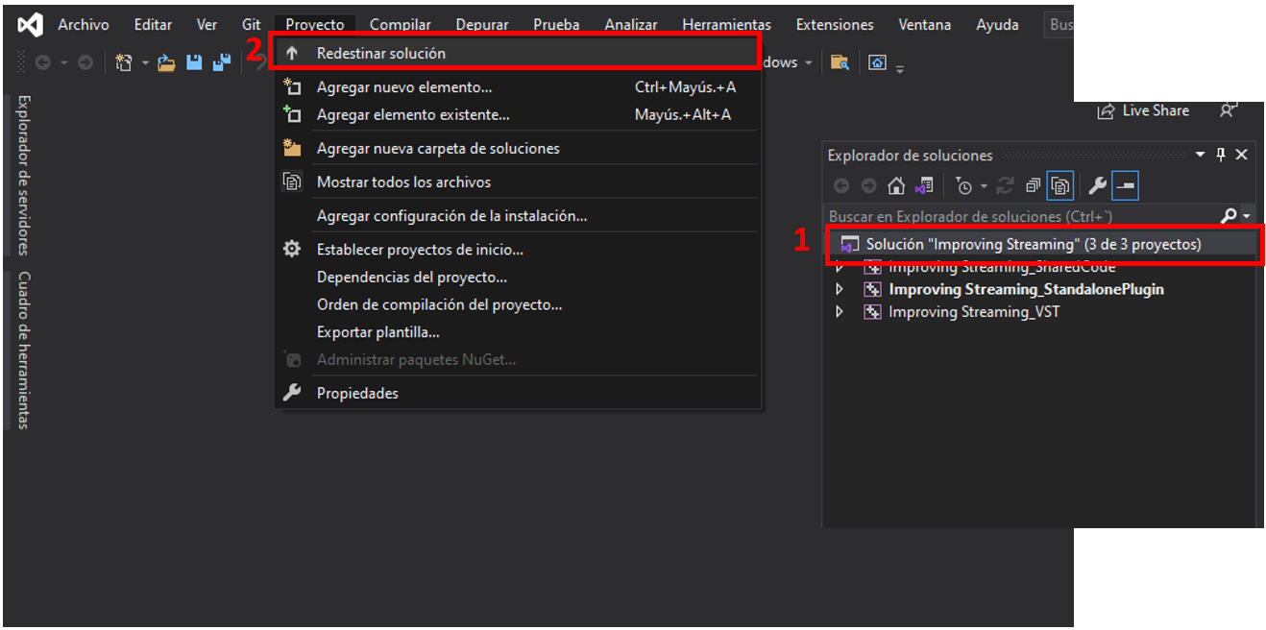
Select the solution on Solution Explorer on the top-right window
On Project menú, select Update Solution (first option, name differs in english) in order to let the Project work with platform tools v142
As originally the Project was created with versión v141, It wont work unless you install that versión, or you update that references to platform libraries on the solution via the way shown.

Slide 6
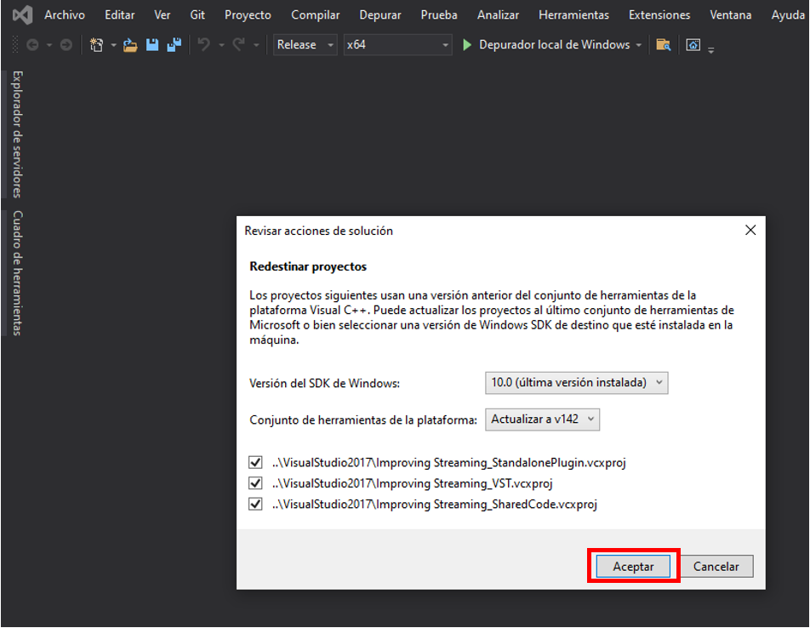
Let Visual Studio do that work clicking Ok button

Slide 7
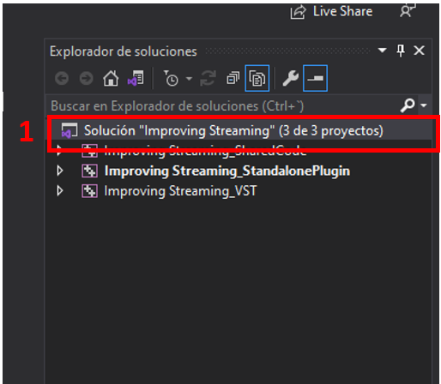
It’s time to compile. First select your solution on Solution Explorer, on top-right window of VS.
Push CTRL+Shift+B on your keyboard or compile it on your preferred way ☺
You will find your generated bin files on
\CodigoPlugin\Improving Streaming\examples\ImprovingStreaming\Builds\VisualStudio2017\x64

Slide 8
How to use Improving Streaming plugin with OBS software

Slide 9
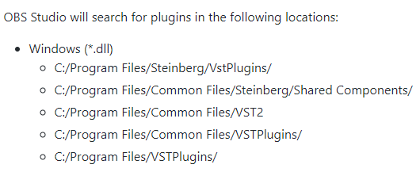
First step is to place ImprovingStreming.dll vst2 file on one of the folders listed here
Preferred paths are listed below

Slide 10
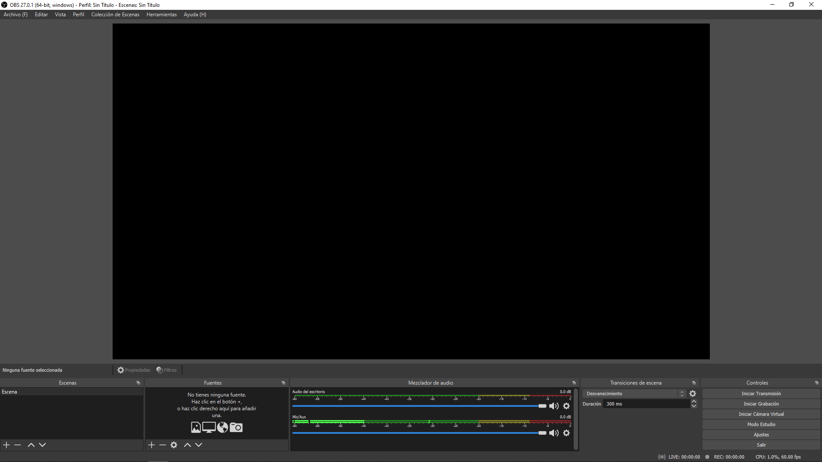
Open OBS
If asked, apply suggested detected settings

Slide 11
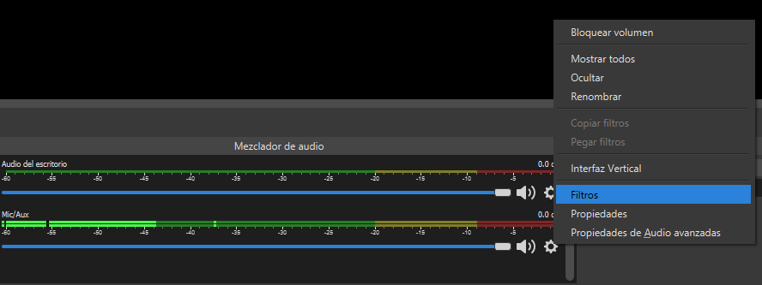
On Audio Mixer section, click on the gearwheel to open settings, and select Filters on the menu
2
1

Slide 12
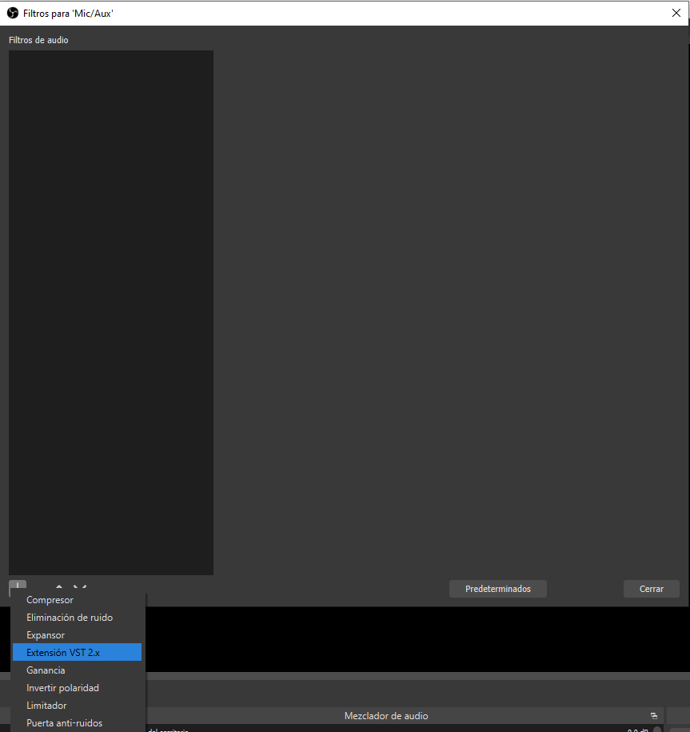
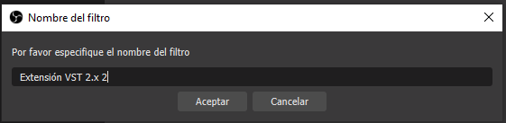
On recently opened filter window, click on the PLUS + From the bottom left of the list,
In order to add an VST 2.x plugin
Put your favourite namefor the plugin and click OK
3
1
2

Slide 13
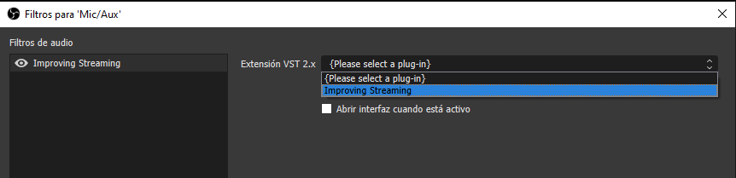
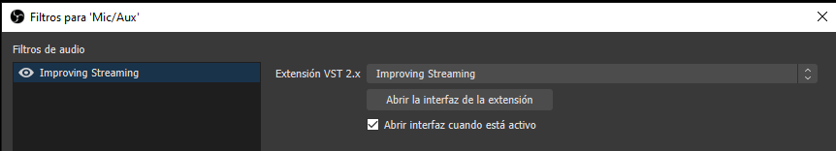
1
Select Improving Streaming plugin detected on one of first slide described paths: You can tick Open interface when active in order to keep plugin Window open while operating, or just
2
You can tick Open interface when active in order to keep plugin Window open while operating, or just open plug in interface from marked option

Slide 14
On recently opened filter window, click on the PLUS + From the bottom left of the list,
In order to add an VST 2.x plugin
Put your favourite namefor the plugin and click OK
3
1
2

Slide 15
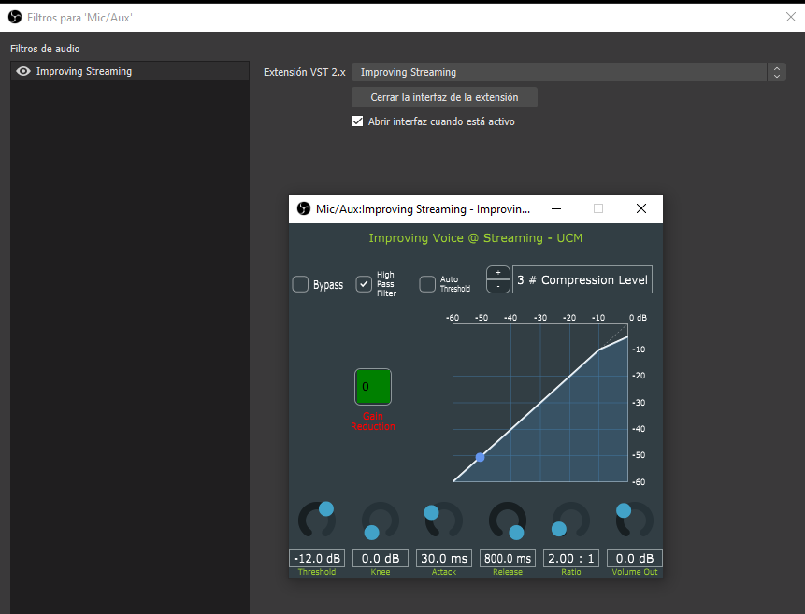
Improving Streaming is now fully operationalwith OBS letting you control your audio signal! ☺

Slide 16
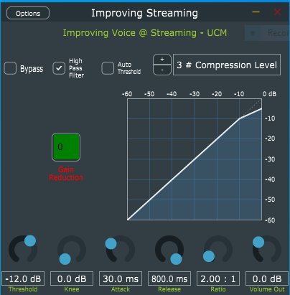
Select your preset using “Compression Level” Increment/Decrement button. Choose a lower preset for a less compressed voice and a higher one for a more compressed output.
Choose either Auto-threshold option or manual configuration. If auto option is chosen turn it on and go straight to point 3, else If you decide to adjust it manually:
Turn off Auto-Threshold and set Compression level to 3.
try to reach “-3db” gain reduction and keep the square on green – greenyellow color values limiting input signal with threshold slider. Move it while you speak and look for green colour on the square.
Adjust “Volume Out” in order to keep green metering in OBS, next step on your audio chain
Choose filtering your voice with a high pass filter or let it be….
Use Bypass to check difference between your favourite configurations!
Enjoy trying different values of compression level and choose the best for your voice! (Squeeze Threshold for more compression with the preset of your choice!)
5
4
2
1
2.2
“Keep it green” zone
6
3

